Slide 1
To create a happier and healthier city!
For all teenagers in Bradford
Year 9 Health Measures
Notes:
Hello Year 9. I’m….. and I’m …. and we are research assistants from the Born in Bradford Age of Wonder project.
Our team visited your school earlier this year to tell you all about the Born in Bradford Age of Wonder study so you already know this is the worlds largest research study of teenagers.
Born in Bradford started in 2007 and follows the lives of young people growing up in Bradford.
The babies that were born in 2007 are now teenagers and our new project Age of Wonder is open to all teenagers.
Age of Wonder works with young people in schools to help improve your wellbeing by using the data you provide.
Today we are here to give you the opportunity to take part in measurements of physical health.
.

Slide 2
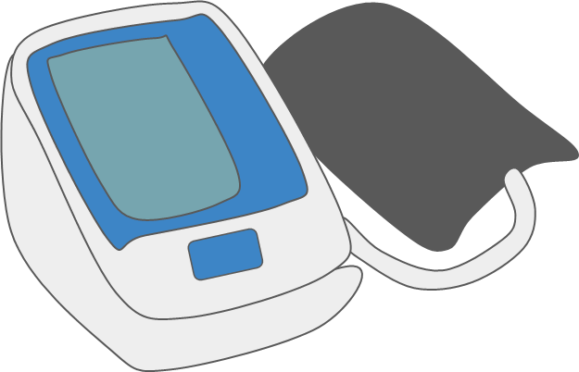
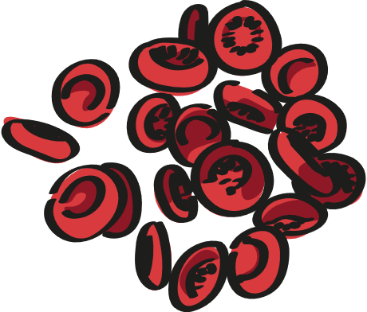
Health Measures
Basic Measures
Blood Samples
Notes:
We only collect health measures in year 9 and we will visit you twice to collect some basic measures like your height and blood pressure and then again to collect some blood samples.
Today we are here to tell you about how you can become involved in giving a small sample of blood.
You’re about to watch a short film, its only two and a half minutes long and it tells you about all the different measures we do including blood samples.

Slide 3
Blood Sample – Yr9 only
893
Young people have already joined in!
Notes:
Today we are inviting you to take part in giving a blood sample.
This is very exciting and we really hope you will take part now as we can only offer this to students in year 9.
Although we are also working with year 8 and 10 students we can only offer the blood sample part of the project in year 9.
Last year 340 students in year 9 across Bradford were eager to take part and now we are giving you the opportunity to join them.
If you decide to take part your blood sample will be sent to the laboratory for routine tests that will add to the data we have and will be used to improve the health of Bradfords teenagers now and in the future.

Slide 4
What do we see in your blood?
White blood cells
Platelets
Genes
Red Blood Cells
What's happening inside your body
Plasma
Notes:
If you decide to take part your sample will be sent to the lab and the biochemists / scientists will spin your sample in a machine called a centrifuge so that the cells drop to the bottom and the plasma stays at the top – then they study your blood cells.
Your blood is made up of plasma, red blood cells, white blood cells and platelets and each part is vital to you staying healthy.
Plasma is a yellow fluid that carries all of the blood cells, vitamins, minerals and nutrients around your body to your organs and tissues.
Red blood cells carry oxygen, white cells fight off infection and platelets stop you bleeding if you cut yourself.
Every cell in your body contains your DNA code and this includes your blood cells.
From the information in your blood sample we can see how well your bones are making new blood cells, how well your lungs are working to put oxygen into your blood, how well your liver is cleaning up your blood and how well your kidneys are getting rid of the waste products you don’t need.
This all leads to a fantastic picture of your health inside your body.

Slide 5
The BIG picture
Social Media
Eating
Emotions & Mental Health
Sleeping
Exercise
Blood sample
Blood Pressure
Growth
Brain Games
Safety
Environment
Notes:
Age of wonder is collecting a wealth of information from you and working with you to change your lives for the better.
Everything we collect is really important, but the majority of the data collected is looking at your health on the outside.
The blood sample is unique, it tells us about what is happening for young people on the inside too.
It’s a vital part of the bigger picture.

Slide 6
FREE health check
Bone pain
Fatigue
Muscle weakness
Muscle aches
Muscle cramps
Mood changes
Signs of low vitamin D
72%
Easy to treat
Low vitamin D results
Signs of normal development
Notes:
There's also another reason you may want to take part.
When your sample goes to the lab we do a free health check.
They let us know if everything is looking good and or if any of your nutrient or cell levels need attention.
For example:
All of the blood samples will be checked to see if you have enough vitamin D
Vitamin D is the vitamin we get from sunshine on our skin and we need it to make strong bones that will last a life time.
Last year we found 72% of young people had low vitamin D levels – this is important because low vitamin D can result in your bones being curved, thin and easily breakable.
Having low vitamin D can make you tired because your body has to work extra hard to make your bones grow. It can also make your bones and muscles ache because they are not as strong as they should be. Low vitamin levels can be easily missed in teenagers as the signs are very similar to the usual growing aches and pains we associate with adolescence.
Low vitamin D levels are really easy to treat with a daily vitamin D supplement and we would contact your carer or doctor and arrange this for you. So please take this opportunity to take part in the year 9 health measures by giving a small blood sample: Not only will be contributing to improving the health and lives of the teenagers across the city but you will also get a free health check that could make a big difference to your health right now.

Slide 7
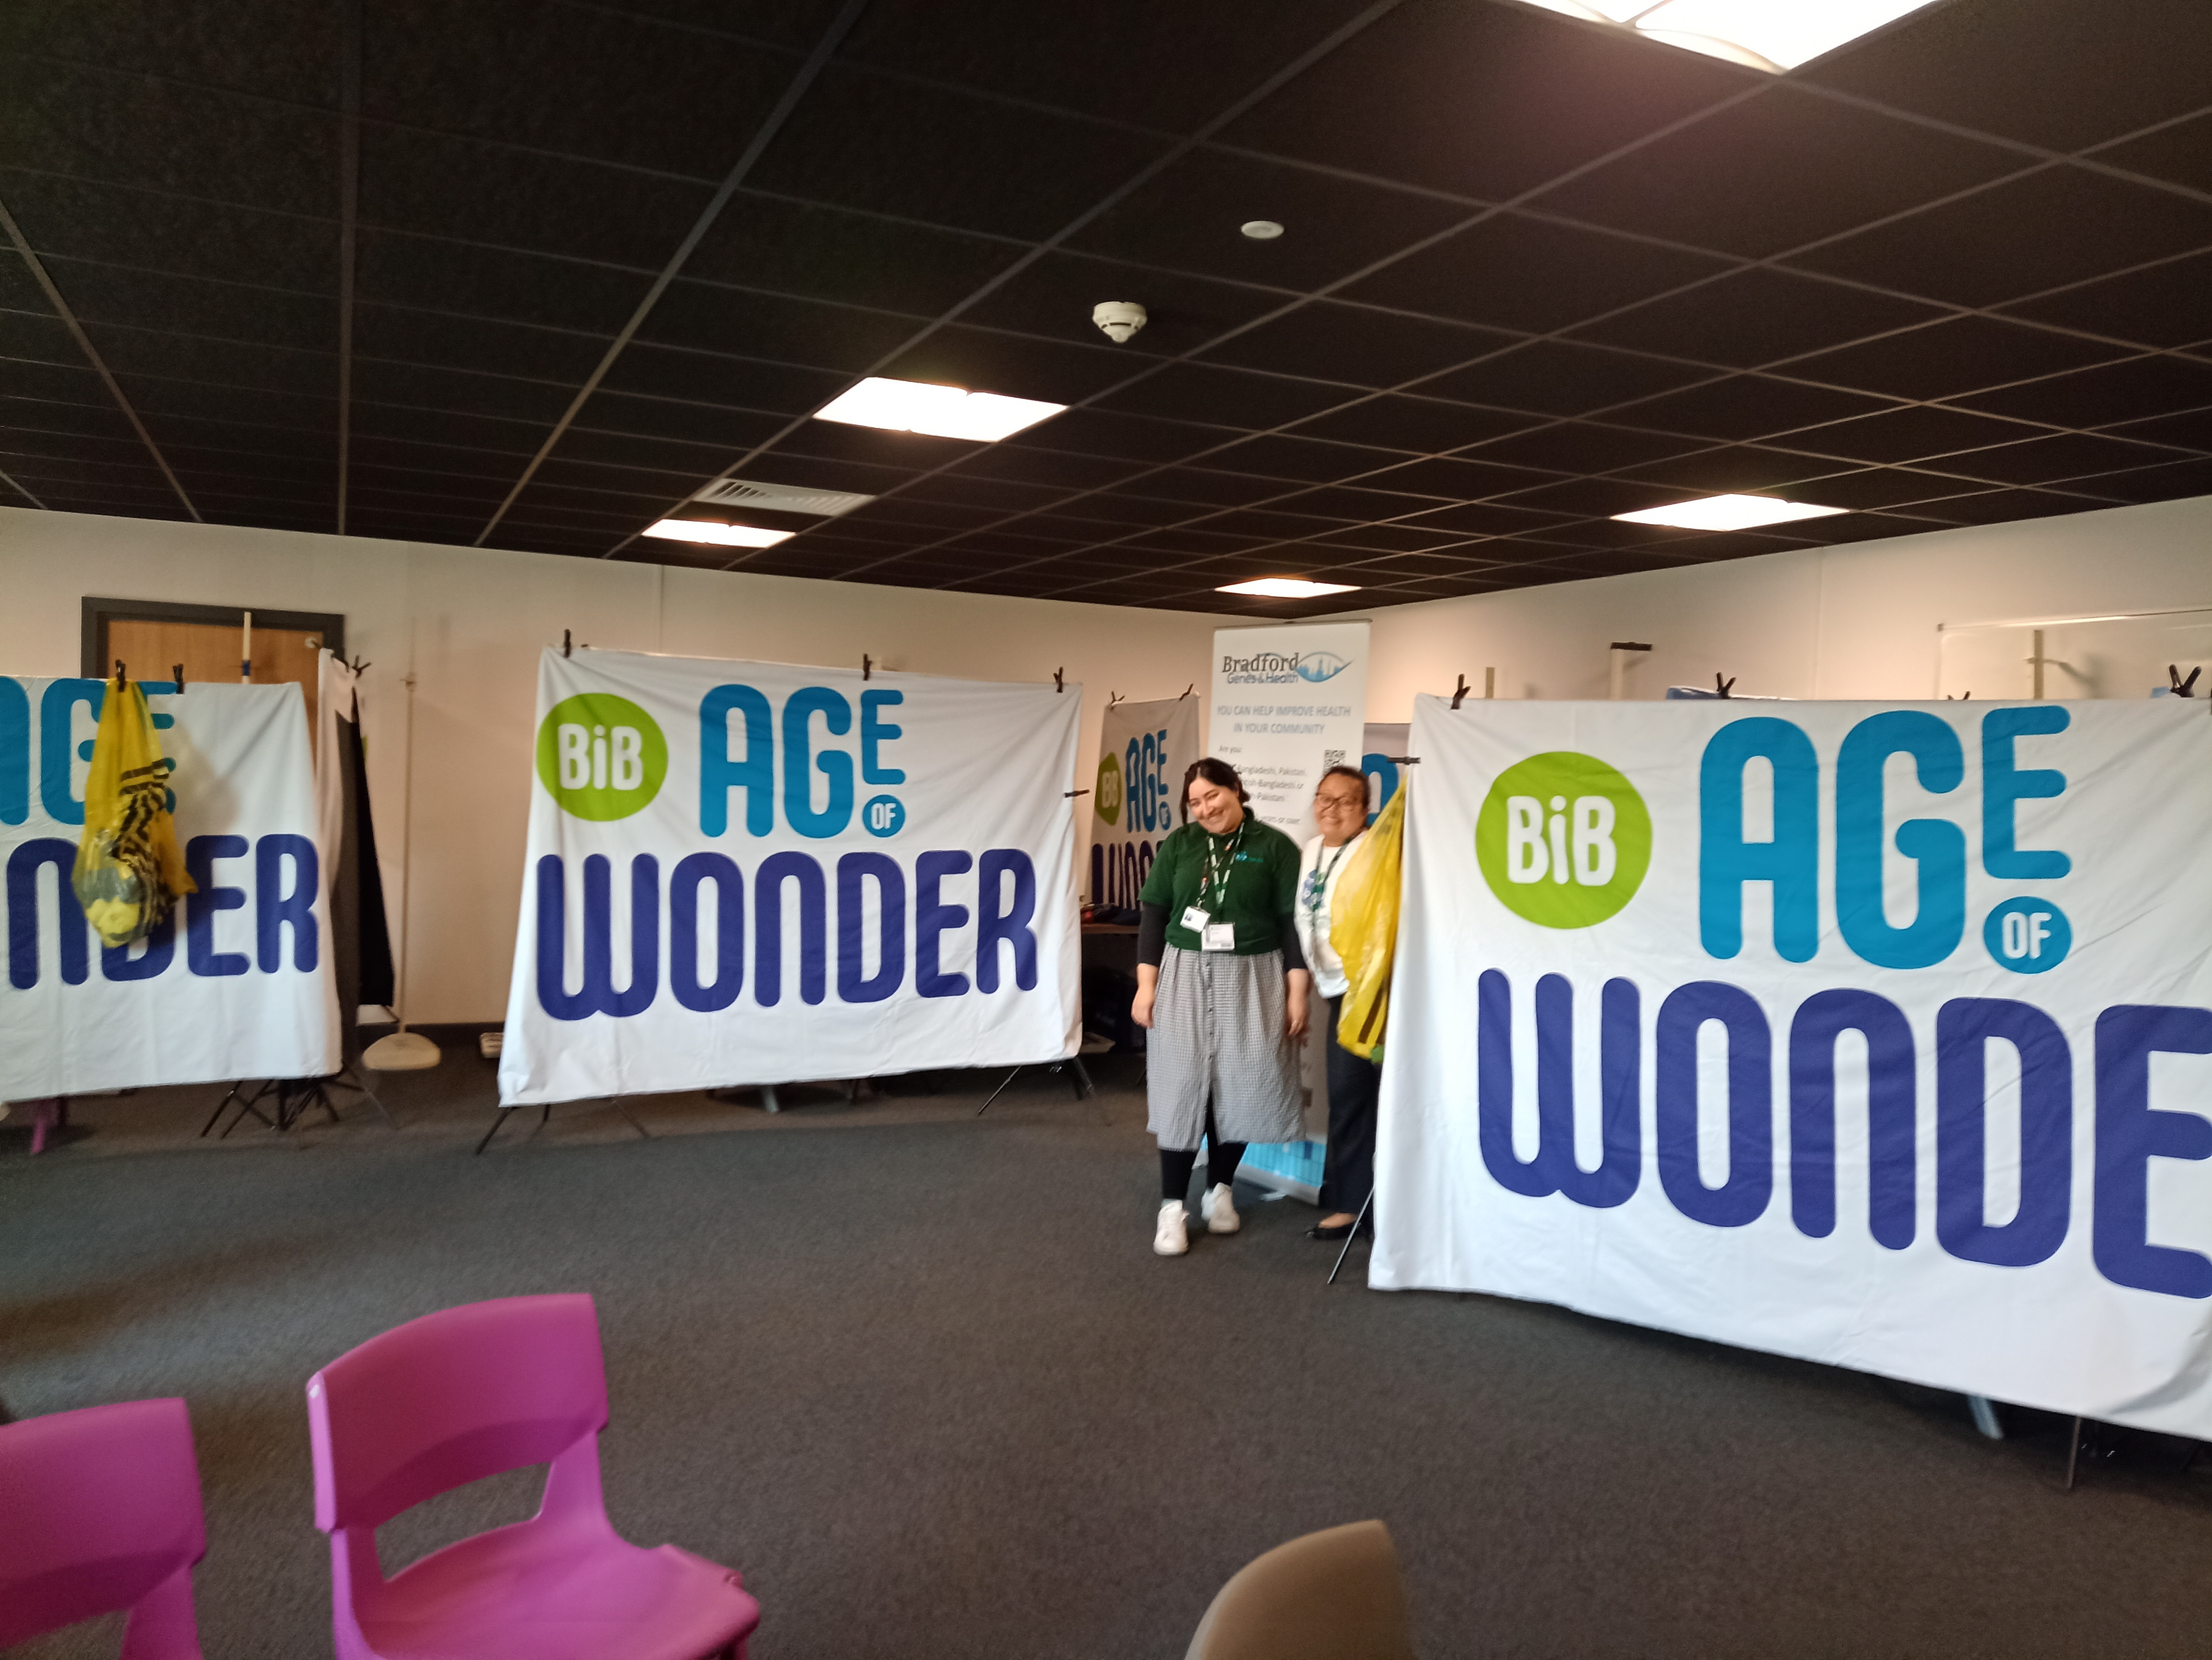
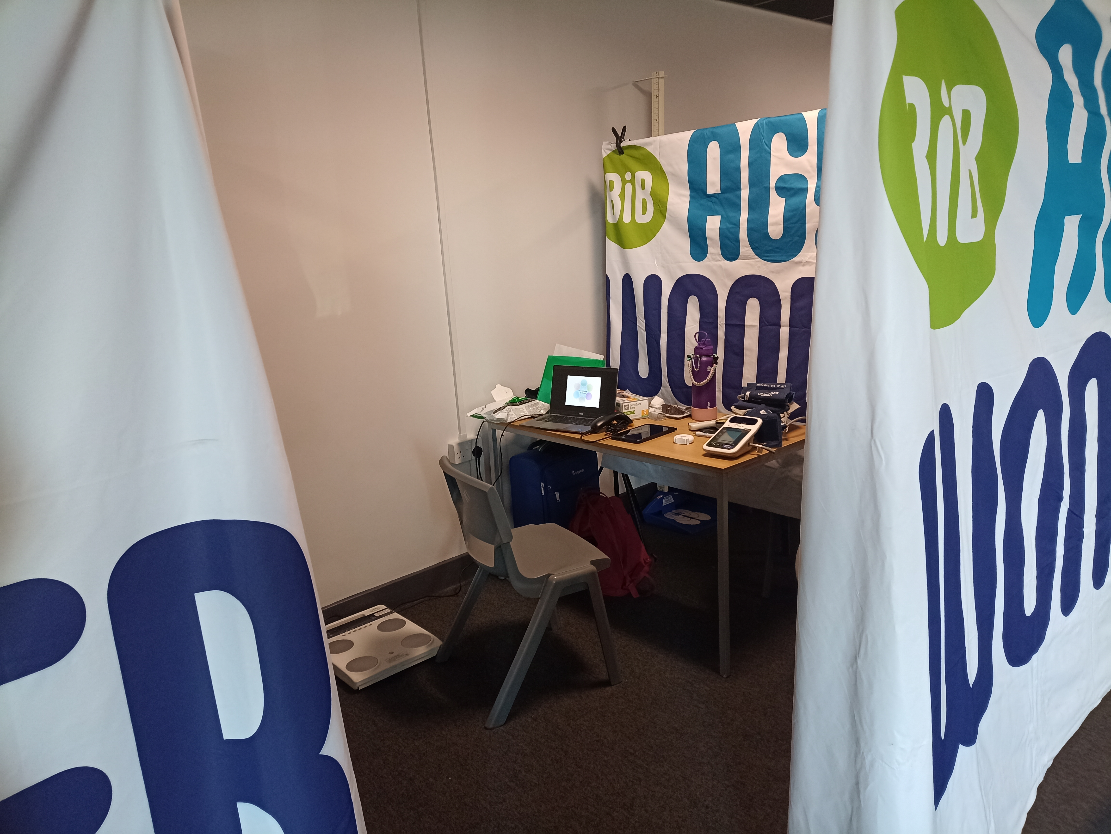
What happens on the day?
We will call you from lesson
We will ask you if you want to go ahead
You will be seen in a private booth
Notes:
If you decide to take part blood samples are a quick and easy test, millions of people give samples for all sort of reasons all over the world and our research assistants are here to support you on the day. When you give a blood sample you may sometimes feel a scratch, but we use a cold spray to help with this.
Your school think that this is a good idea, and so they help us with setting up an area in school for you to be seen.
You will be taken out of lesson and brought to a room in school where we will have constructed some booths using large banners like you can see in the first picture.
We will check your name and dob and ask you if you still want to go ahead – remember - you can change your mind at any time.
You will go into one of the booths, like in the second photograph and see a research assistant

Slide 8
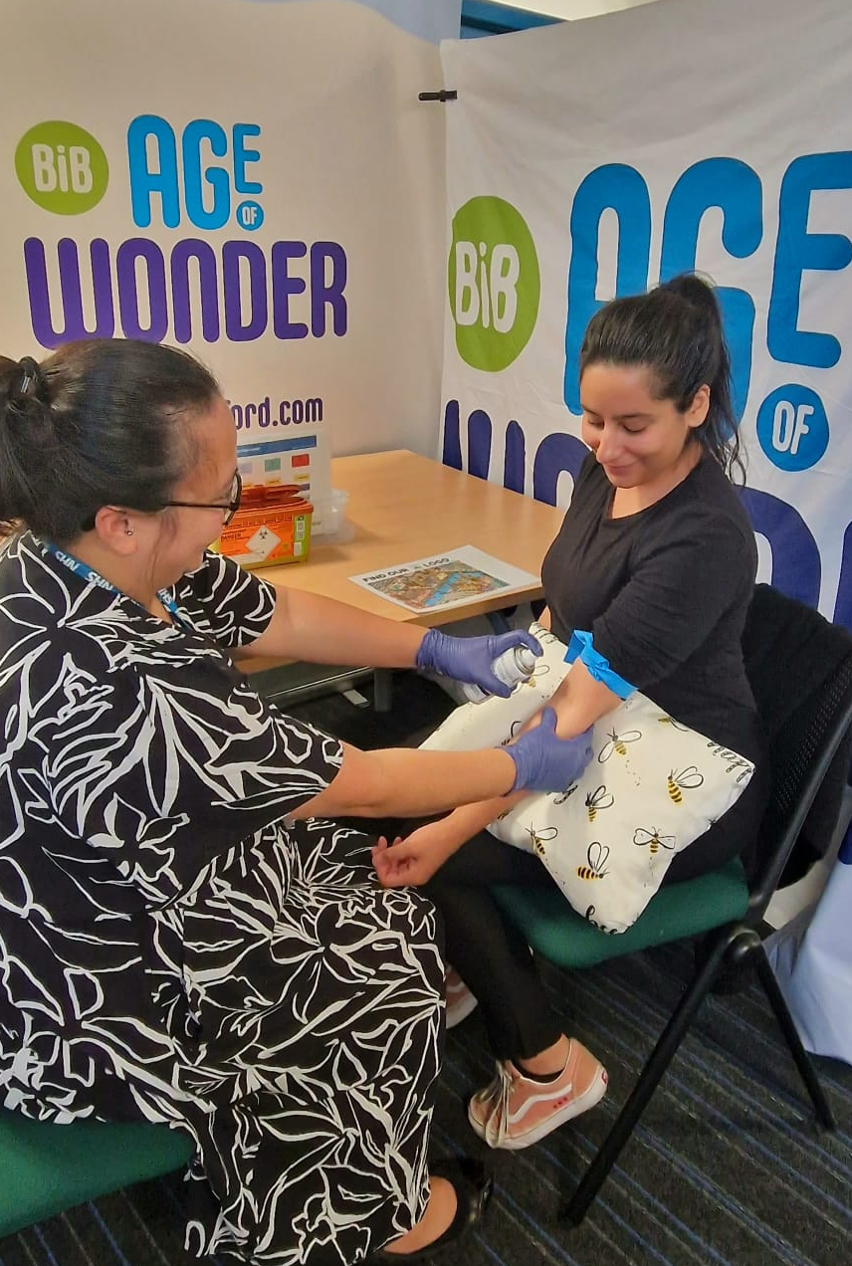
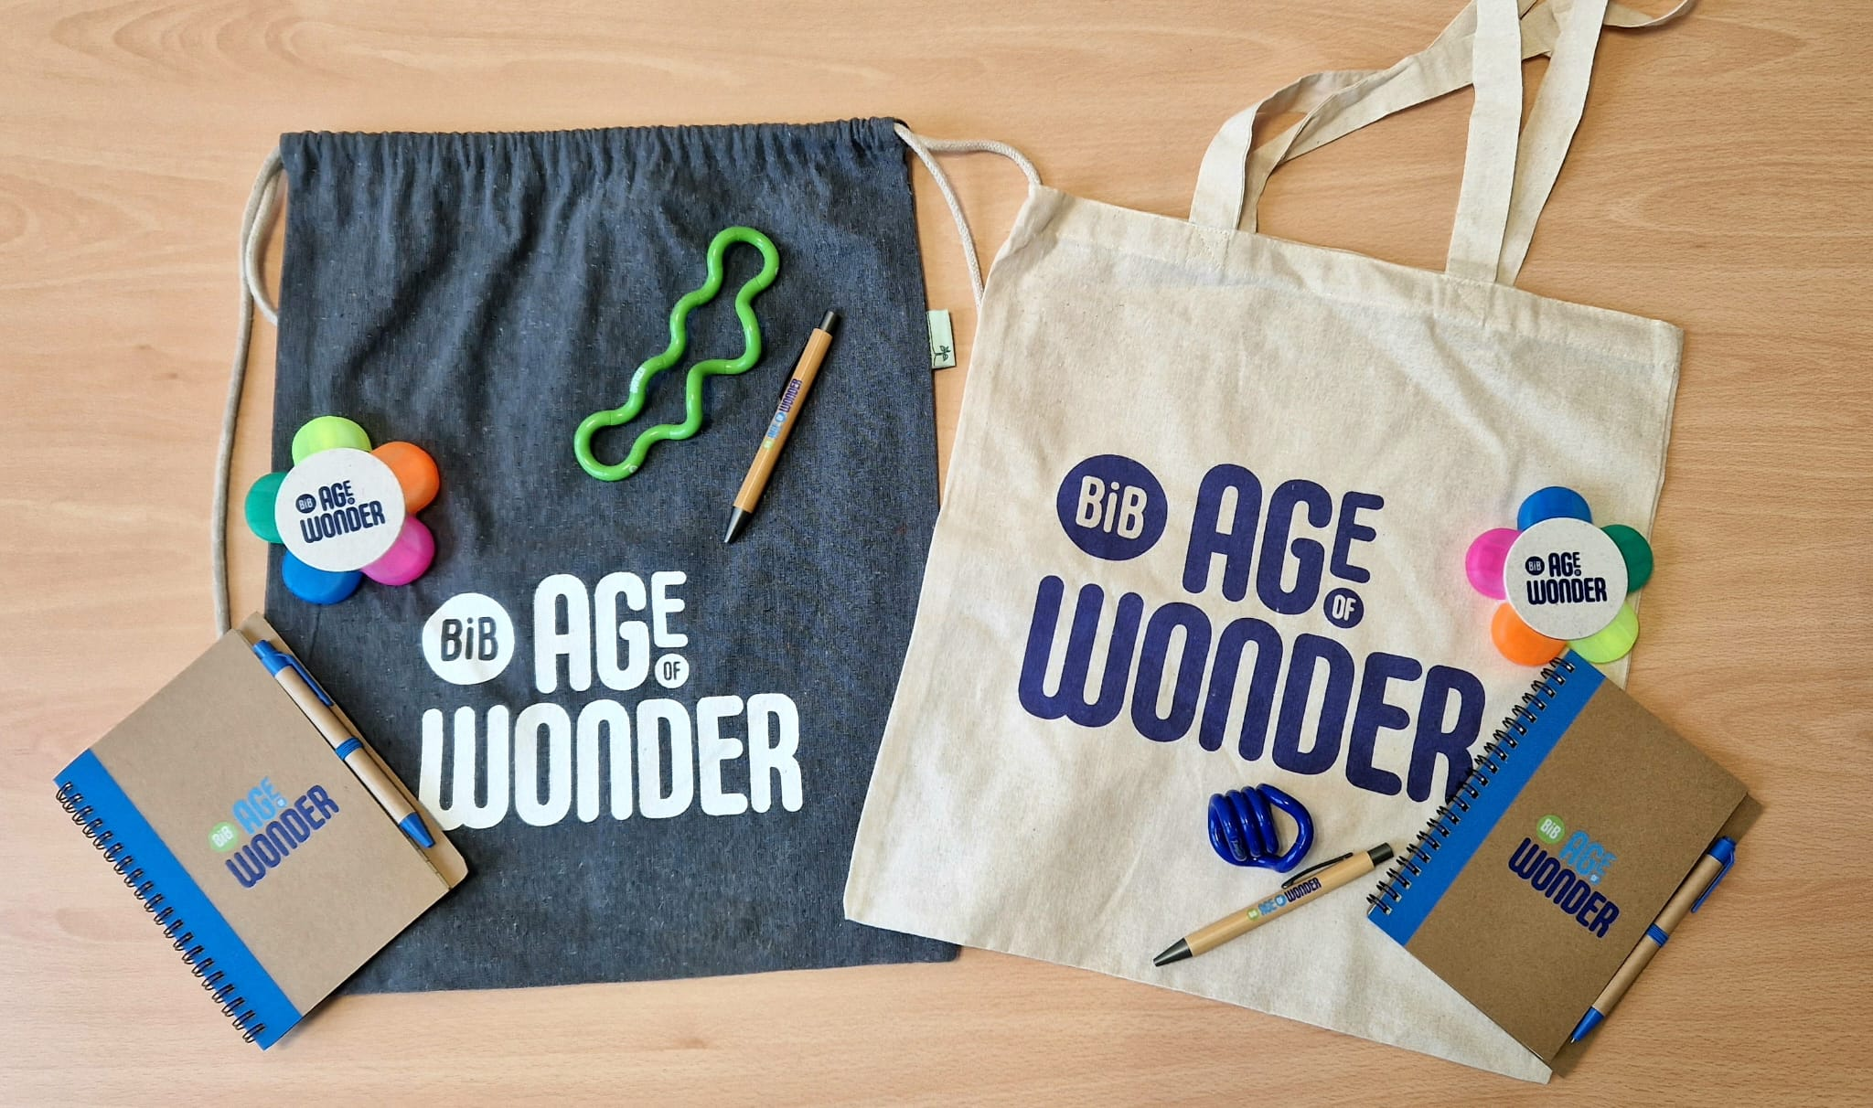
What happens on the day?
We will ask you to take off your blazer or jumper and roll up your sleeve
We can use a spray that makes your skin cold and numb
You can change your mind at any time
Notes:
We ask you to take off your blazer and roll up your sleeve.
We can use a spray that makes your skin cold and numb if you want to use this
If you feel a little nervous we have some great ‘where’s wally’ distraction aids
We use a very small needle and take approx. 4 teaspoons or 22mls of blood in sample bottles
Afterwards you sit for a few minutes with a drink and a snack
We have some great eco-friendly thank you gifts that we give you for taking part before you return to lesson

Slide 9
Keeping your information safe
Remember:
All your information will remain confidential throughout
Notes:
Just a quick reminder that all of the information that we collect on the age of wonder project is confidential.
We use codes to make sure that your personal information like your name, your age and date of birth cannot be linked to any of the information we collect.
When we take a blood sample, we replace your details with a barcode and from then on this is the only way the sample can be identified – as a number and code which is not linked to you.

Slide 10
Permission forms
Paper Forms
Online Forms
Your parents/carers must fill in the form if you DO want to take part
Notes:
In order to take part you need your parent or carers permission
The next part needs to be tailored to the schools preference.
For the video:
Your school will let you know if they are sending home paper forms for consent or emailing your parents.
If it’s a paper form there are a couple of ways the form can be completed:
Show the form to your parents or carers and ask them to fill in the paper form and you then hand it in at school.
There's also a QR code on the paper form that your parents or carers can scan to fill in the form online.
OR: If it an electronic form your parents and carers will be sent an email from school with a link to the permission form so that they can fill it in online.
Please talk to your parents and carers and let them know you’d like to take part and ask them to complete the form.
In school: Paper forms only:
We are giving you a permission form to take home.
There are a couple of ways the form can be completed:
Show the form to your parents or carers and ask them to fill in the paper form and you then hand in at school.
There's also a QR code on the paper form that your parents or carers can scan to fill in the form online.
In school: Email only:
Your parents and carers will be sent an email from school with a link to the permission form so that they can fill it in online.
Please talk to your parents and carers and let them know you’d like to take part and ask them to complete the form.
In school: Paper and email:
We are giving you a permission form to take home.
There are a couple of ways the form can be completed:
Show the form to your parents or carers and ask them to fill in the paper form and you then hand in at school.
There's also a QR code on the paper form that your parents or carers can scan to fill in the form online.
Your parents and carers will be sent an email from school with a link to the permission form so that they can fill it in online.
Please talk to your parents and carers and let them know you’d like to take part and ask them to complete the form.

Slide 11
Please complete and return by 28th April!
Notes:
For the video:
Your school will let you know the hand in date for the forms.
If you have any questions that you want to ask please DM us @bibageofwonder
Thank you all for listening and we hope to see lots of you when we visit your school.
In school:
The last hand in date for the permission forms is….
Does anyone have any questions?
If you have any questions that you want to ask please DM us @bibageofwonder
Thank you all for listening and we hope to see lots of you when we visit your school.

